Slide 1
Project 4 Awards First Place
Group 7
Samuel Bartlett
Michael Phillips
Norman Chen
Notes:
Group 7

Slide 2
Project 4 Awards Second Place
Group 15
Michael Pearce
Martin Wang
Michael Volz

Slide 3
Project 4 Awards Second Place
Group 14
Stephen Ward
John Jorgensen
Neal Smith
Group 18
Bridges Penn
James Post

Slide 4
COMP 3500 Introduction to Operating Systems Virtual Memory
Dr. Xiao Qin
Auburn University http://www.eng.auburn.edu/~xqin
xqin@auburn.edu
Slides are adopted and modified from materials developed by Drs. Silberschatz, Galvin, and Gagne

Slide 5
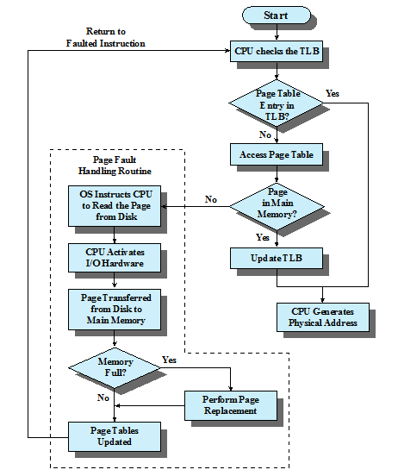
Review: Paging and Translation Lookaside Buffer (TLB)

Slide 6
Segment Organization
Each segment table entry contains the starting address of the corresponding segment in main memory and the length of the segment
A bit is needed to determine if the segment is already in main memory
Another bit is needed to determine if the segment has been modified since it was loaded in main memory
Notes:
In the discussion of simple segmentation, we indicated that each
process has its own segment table, and when all of its segments are loaded into main
memory, the segment table for a process is created and loaded into main memory.
Each segment table entry contains the starting address of the corresponding segment
in main memory, as well as the length of the segment. The same device, a segment
table, is needed when we consider a virtual memory scheme based on segmentation.
Again, it is typical to associate a unique segment table with each process. In this
case, however, the segment table entries become more complex ( Figure 8.1b ).
Because only some of the segments of a process may be in main memory, a bit is
needed in each segment table entry to indicate whether the corresponding segment
is present in main memory or not. If the bit indicates that the segment is in memory,
then the entry also includes the starting address and length of that segment.
Another control bit in the segmentation table entry is a modify bit, indicating
whether the contents of the corresponding segment have been altered since the segment
was last loaded into main memory. If there has been no change, then it is not
necessary to write the segment out when it comes time to replace the segment in the
frame that it currently occupies. Other control bits may also be present. For example,
if protection or sharing is managed at the segment level, then bits for that purpose
will be required.
Segmentation allows the programmer to view memory as consisting of multiple address spaces or segments.
Segments may be of unequal, indeed dynamic, size.
Memory references consist of a form of address (segment number, offset).
This organization has a number of advantages to the programmer over a nonsegmented address space:
It simplifies the handling of growing data structures.
If the programmer doesn’t know ahead of time how large a particular data structure will become, it is necessary to guess unless dynamic segment sizes are allowed. With segmented virtual memory, the data structure can be assigned its own segment, and the operating system will expand or shrink the segment as needed.
If a segment that needs to be expanded is in main memory and there is insufficient room, the operating system may move the segment to a larger area of main memory, if available, or swap it out. The enlarged segment would be swapped back in at the next opportunity.
2. It allows programs to be altered and recompiled independently,
without requiring the entire set of programs to be relinked and reloaded.
Again, this is accomplished using multiple segments.
3. It lends itself to sharing among processes.
A programmer can place a utility program or a useful table of data in a segment that can be referenced by other processes.
4. It lends itself to protection.
Because a segment can be constructed to contain a well-defined set of programs or data, the programmer or system administrator can assign access privileges in a convenient fashion.

Slide 7
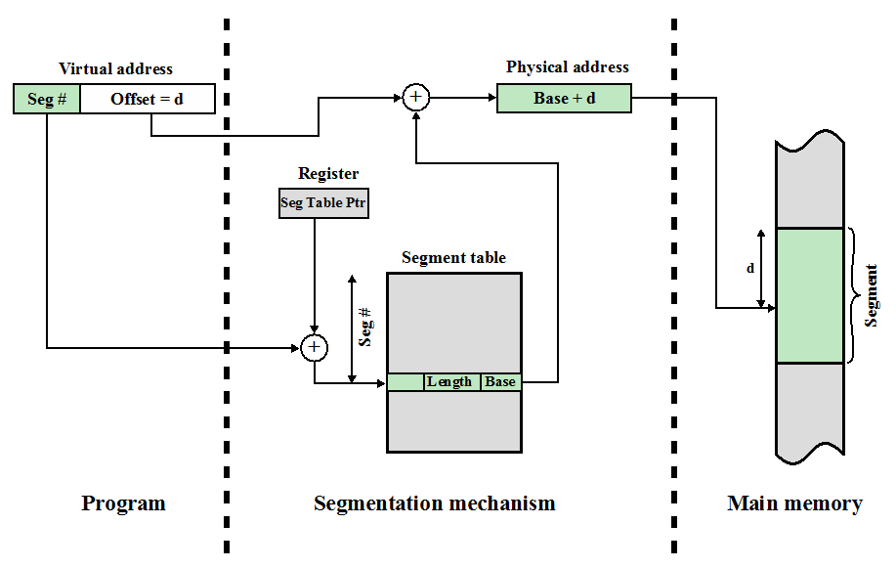
Address Translation in a Segmentation System
Notes:
The basic mechanism for reading a word from memory involves the translation
of a virtual, or logical, address, consisting of segment number and offset, into a physical
address, using a segment table. Because the segment table is of variable length,
depending on the size of the process, we cannot expect to hold it in registers. Instead,
it must be in main memory to be accessed. Figure 8.11 suggests a hardware implementation
of this scheme (note similarity to Figure 8.2 ). When a particular process
is running, a register holds the starting address of the segment table for that process.
The segment number of a virtual address is used to index that table and look up the
corresponding main memory address for the start of the segment. This is added to
the offset portion of the virtual address to produce the desired real address.

Slide 8
Combined Paging and Segmentation
A user’s address space is broken up into a number of segments.
Each segment is broken up into a number of fixed-sized pages
Each page is equal in length to a main memory frame
Segmentation is visible to the programmer
Paging is transparent to the programmer
Notes:
Question: segments in a page or pages in a segment?
Both paging and segmentation have their strengths. Paging, which is transparent
to the programmer, eliminates external fragmentation and thus provides efficient
use of main memory. In addition, because the pieces that are moved in and out of
main memory are of fixed, equal size, it is possible to develop sophisticated memory
management algorithms that exploit the behavior of programs, as we shall see.
Segmentation, which is visible to the programmer, has the strengths listed earlier,
including the ability to handle growing data structures, modularity, and support
for sharing and protection. To combine the advantages of both, some systems are
equipped with processor hardware and operating system software to provide both.
In a combined paging/segmentation system, a user’s address space is broken
up into a number of segments, at the discretion of the programmer. Each segment
is, in turn, broken up into a number of fixed-size pages, which are equal in length to
a main memory frame. If a segment has length less than that of a page, the segment
occupies just one page. From the programmer’s point of view, a logical address still
consists of a segment number and a segment offset. From the system’s point of view,
the segment offset is viewed as a page number and page offset for a page within the
specified segment.

Slide 9
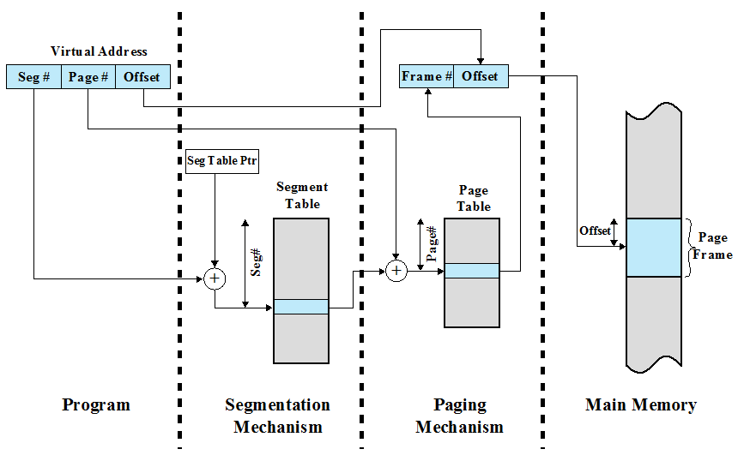
Address Translation in a Segmentation/Paging System
Notes:
This figure suggests a structure to support combined paging/segmentation
(note similarity to Figure 8.4 ). Associated with each process is a segment table and
a number of page tables, one per process segment. When a particular process is
running, a register holds the starting address of the segment table for that process.
Presented with a virtual address, the processor uses the segment number portion to
index into the process segment table to find the page table for that segment. Then
the page number portion of the virtual address is used to index the page table and
look up the corresponding frame number. This is combined with the offset portion
of the virtual address to produce the desired real address.

Slide 10
Notes:
Figure c suggests the segment table entry and page table entry formats. As
before, the segment table entry contains the length of the segment. It also contains
a base field, which now refers to a page table. The present and modified bits are not
needed because these matters are handled at the page level. Other control bits may
be used, for purposes of sharing and protection. The page table entry is essentially
the same as is used in a pure paging system. Each page number is mapped into a corresponding
frame number if the page is present in main memory. The modified bit
indicates whether this page needs to be written back out when the frame is allocated
to another page. There may be other control bits dealing with protection or other
aspects of memory management.

Slide 11
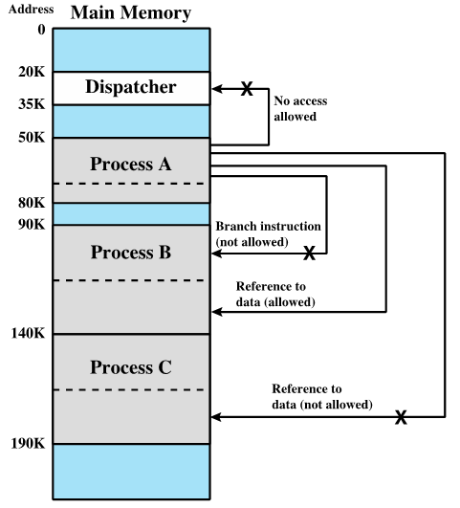
Protection and Sharing
Segmentation lends itself to the implementation of protection and sharing policies
Each entry has a base address and length so inadvertent memory access can be controlled
Sharing can be achieved by segments referencing multiple processes
Notes:
This figure illustrates the types of protection relationships that can be enforced in such a system.
More sophisticated mechanisms can also be provided. A common scheme is
to use a ring-protection structure, of the type we referred to in Chapter 3 ( Figure
3.18 ). In this scheme, lower-numbered, or inner, rings enjoy greater privilege than
higher-numbered, or outer, rings. Typically, ring 0 is reserved for kernel functions
of the operating system, with applications at a higher level. Some utilities or operating
system services may occupy an intermediate ring. Basic principles of the ring
system are as follows:
1. A program may access only data that reside on the same ring or a less privileged
ring.
2. A program may call services residing on the same or a more privileged ring.

Slide 12
Operating System Software
The design of the memory management portion of an operating system depends on:
whether or not to use virtual memory techniques
the use of paging or segmentation or both
the algorithms employed for various aspects of memory management
Notes:
The design of the memory management portion of an operating system depends on
three fundamental areas of choice:
• Whether or not to use virtual memory techniques
• The use of paging or segmentation or both
• The algorithms employed for various aspects of memory management
The choices made in the first two areas depend on the hardware platform available.
Thus, earlier UNIX implementations did not provide virtual memory because the
processors on which the system ran did not support paging or segmentation. Neither
of these techniques is practical without hardware support for address translation
and other basic functions.
Two additional comments about the first two items in the preceding list: First,
with the exception of operating systems for some of the older personal computers,
such as MS-DOS, and specialized systems, all important operating systems provide
virtual memory. Second, pure segmentation systems are becoming increasingly rare.
When segmentation is combined with paging, most of the memory management
issues confronting the operating system designer are in the area of paging. Thus,
we can concentrate in this section on the issues associated with paging.
The choices related to the third item are the domain of operating system software
and are the subject of this section.

Slide 13
Operating System Policies for Virtual Memory
Notes:
Key design elements. In each case, the key issue is one of performance: We would like to
minimize the rate at which page faults occur, because page faults cause considerable
software overhead. At a minimum, the overhead includes deciding which resident
page or pages to replace, and the I/O of exchanging pages. Also, the operating system
must schedule another process to run during the page I/O, causing a process
switch. Accordingly, we would like to arrange matters so that, during the time that
a process is executing, the probability of referencing a word on a missing page is
minimized. In all of the areas referred to in Table 8.4 , there is no definitive policy
that works best.
As we shall see, the task of memory management in a paging environment
is fiendishly complex. Furthermore, the performance of any particular set
of policies depends on main memory size, the relative speed of main and secondary
memory, the size and number of processes competing for resources, and the execution
behavior of individual programs. This latter characteristic depends on the nature
of the application, the programming language and compiler employed, the style of
the programmer who wrote it, and, for an interactive program, the dynamic behavior
of the user. Thus, the reader must expect no final answers here or anywhere. For
smaller systems, the operating system designer should attempt to choose a set of policies
that seems “good” over a wide range of conditions, based on the current state of
knowledge. For larger systems, particularly mainframes, the operating system should
be equipped with monitoring and control tools that allow the site manager to tune
the operating system to get “good” results based on site conditions.

Slide 14
Fetch Policy
Determines when a page should be brought into memory
Two main types:
Demand Paging
Prepaging
Notes:
The fetch policy determines when a page should be brought into main memory. The
two common alternatives are demand paging and prepaging.

Slide 15
Demand Paging
Brings pages into main memory when a reference is made to a location on the page
Q1: Many or few page faults when process is first started?
Q2: What happens after more and more pages are brought in?
Principle of locality suggests that as, most future references will be to pages that have recently been brought in, and page faults should drop to a very low level
Notes:
Many page faults.
With demand paging ,
a page is brought into main memory only when a reference is made to a location on
that page. If the other elements of memory management policy are good, the following
should happen. When a process is first started, there will be a flurry of page
faults. As more and more pages are brought in, the principle of locality suggests that
most future references will be to pages that have recently been brought in. Thus,
after a time, matters should settle down and the number of page faults should drop
to a very low level.

Slide 16
Prepaging
Pages other than the one demanded by a page fault are brought in
Exploits the characteristics of most secondary memory devices
If pages of a process are stored contiguously in secondary memory it is more efficient to bring in a number of pages at one time
Q3: What is the downside?
Ineffective if extra pages are not referenced
Notes:
With prepaging , pages other than the one demanded by a page fault are
brought in. Prepaging exploits the characteristics of most secondary memory
devices, such as disks, which have seek times and rotational latency. If the pages of
a process are stored contiguously in secondary memory, then it is more efficient to
bring in a number of contiguous pages at one time rather than bringing them in one
at a time over an extended period. Of course, this policy is ineffective if most of the
extra pages that are brought in are not referenced.
The prepaging policy could be employed either when a process first starts up,
in which case the programmer would somehow have to designate desired pages, or
every time a page fault occurs. This latter course would seem preferable because
it is invisible to the programmer. However, the utility of prepaging has not been
established [MAEK87].
Prepaging should not be confused with swapping. When a process is swapped
out of memory and put in a suspended state, all of its resident pages are moved out.
When the process is resumed, all of the pages that were previously in main memory
are returned to main memory.

Slide 17
Placement Policy
Determines where in real memory a process piece is to reside
Important design issue in a segmentation system
Paging or combined paging with segmentation placing is irrelevant because hardware performs functions with equal efficiency
For NUMA systems an automatic placement strategy is desirable
Notes:
The placement policy determines where in real memory a process piece is to reside.
In a pure segmentation system, the placement policy is an important design issue;
policies such as best-fit, first-fit, and so on, which were discussed in Chapter 7 , are
possible alternatives. However, for a system that uses either pure paging or paging
combined with segmentation, placement is usually irrelevant because the address
translation hardware and the main memory access hardware can perform their
functions for any page-frame combination with equal efficiency.
There is one area in which placement does become a concern, and this is a
subject of research and development. On a so-called nonuniform memory access
(NUMA) multiprocessor, the distributed, shared memory of the machine can be
referenced by any processor on the machine, but the time for accessing a particular
physical location varies with the distance between the processor and the memory
module. Thus, performance depends heavily on the extent to which data reside
close to the processors that use them [LARO92, BOLO89, COX89]. For NUMA
systems, an automatic placement strategy is desirable to assign pages to the memory
module that provides the best performance.

Slide 18
Replacement Policy
Deals with the selection of a page in main memory to be replaced when a new page must be brought in
Objective: the page that is removed should be the page least likely to be referenced in the near future
The more elaborate the replacement policy the greater the hardware and software overhead to implement it
Notes:
In most operating system texts, the treatment of memory management includes a
section entitled “replacement policy,” which deals with the selection of a page in
main memory to be replaced when a new page must be brought in. This topic is
sometimes difficult to explain because several interrelated concepts are involved:
• How many page frames are to be allocated to each active process
• Whether the set of pages to be considered for replacement should be limited
to those of the process that caused the page fault or encompass all the page
frames in main memory
• Among the set of pages considered, which particular page should be selected
for replacement
We shall refer to the first two concepts as resident set management , which is dealt
with in the next subsection, and reserve the term replacement policy for the third
concept, which is discussed in this subsection.
The area of replacement policy is probably the most studied of any area of
memory management. When all of the frames in main memory are occupied and
it is necessary to bring in a new page to satisfy a page fault, the replacement policy
determines which page currently in memory is to be replaced. All of the policies
have as their objective that the page that is removed should be the page least likely
to be referenced in the near future. Because of the principle of locality, there is
often a high correlation between recent referencing history and near-future referencing
patterns. Thus, most policies try to predict future behavior on the basis of
past behavior. One trade-off that must be considered is that the more elaborate and
sophisticated the replacement policy, the greater will be the hardware and software
overhead to implement it.

Slide 19
Frame Locking
When a frame is locked the page currently stored in that frame may not be replaced.
Q4: What pages should be locked?
kernel of the OS as well as key control structures are held in locked frames
I/O buffers and time-critical areas may be locked into main memory frames
locking is achieved by associating a lock bit with each frame
Notes:
One restriction on replacement policy needs to be mentioned
before looking at various algorithms: Some of the frames in main memory may be
locked. When a frame is locked, the page currently stored in that frame may not be
replaced. Much of the kernel of the OS, as well as key control structures, are held in
locked frames. In addition, I/O buffers and other time-critical areas may be locked
into main memory frames. Locking is achieved by associating a lock bit with each
frame. This bit may be kept in a frame table as well as being included in the current
page table.

Slide 20
Basic Algorithms
Algorithms used for the selection of a page to replace:
Optimal
Least recently used (LRU)
First-in-first-out (FIFO)
Clock
Notes:
Regardless of the resident set management strategy (discussed
in the next subsection), there are certain basic algorithms that are used for the
selection of a page to replace. Replacement algorithms that have been discussed in
the literature include
• Optimal
• Least recently used (LRU)
• First-in-first-out (FIFO)
• Clock

Slide 21
Least Recently Used (LRU)
Replaces the page that has not been referenced for the longest time
By the principle of locality, this should be the page least likely to be referenced in the near future
Notes:
The least recently used (LRU) policy replaces the page in memory that has
not been referenced for the longest time. By the principle of locality, this should
be the page least likely to be referenced in the near future. And, in fact, the LRU
policy does nearly as well as the optimal policy. The problem with this approach is
the difficulty in implementation. One approach would be to tag each page with the
time of its last reference; this would have to be done at each memory reference,
both instruction and data. Even if the hardware would support such a scheme, the
overhead would be tremendous. Alternatively, one could maintain a stack of page
references, again an expensive prospect.

Slide 22
Amazon Interview Question for Software Engineer / Developers
Implement an LRU cache
Q5: How to implement LRU?
one approach is to tag each page with the time of last reference
this requires a great deal of overhead
Notes:
Reference:
1. http://www.roseindia.net/java/example/java/util/LRUCacheExample.shtml
2. http://www.careercup.com/question?id=63645

Slide 23
First-in-First-out (FIFO)
Treats page frames allocated to a process as a circular buffer
Pages are removed in round-robin style
A Simple replacement policy to implement
Page that has been in memory the longest is replaced
Notes:
The first-in-first-out (FIFO) policy treats the page frames allocated to a process
as a circular buffer, and pages are removed in round-robin style. All that is
required is a pointer that circles through the page frames of the process. This is
therefore one of the simplest page replacement policies to implement. The logic
behind this choice, other than its simplicity, is that one is replacing the page that
has been in memory the longest: A page fetched into memory a long time ago may
have now fallen out of use. This reasoning will often be wrong, because there will
often be regions of program or data that are heavily used throughout the life of a
program. Those pages will be repeatedly paged in and out by the FIFO algorithm.

Slide 24
Clock Policy
Requires the association of an additional bit with each frame: referred to as the use bit
When a page is first loaded in memory or referenced, the use bit is set to 1
The set of frames is considered to be a circular buffer
Any frame with a use bit of 1 is passed over by the algorithm
Page frames visualized as laid out in a circle
Notes:
The simplest form of clock policy requires the association of an additional
bit with each frame, referred to as the use bit. When a page is first loaded into a
frame in memory, the use bit for that frame is set to 1. Whenever the page is subsequently
referenced (after the reference that generated the page fault), its use bit is
set to 1. For the page replacement algorithm, the set of frames that are candidates
for replacement (this process: local scope; all of main memory: global scope ) is
considered to be a circular buffer, with which a pointer is associated. When a page
is replaced, the pointer is set to indicate the next frame in the buffer after the one
just updated. When it comes time to replace a page, the operating system scans
the buffer to find a frame with a use bit set to 0. Each time it encounters a frame
with a use bit of 1, it resets that bit to 0 and continues on. If any of the frames in
the buffer have a use bit of 0 at the beginning of this process, the first such frame
encountered is chosen for replacement. If all of the frames have a use bit of 1, then
the pointer will make one complete cycle through the buffer, setting all the use bits
to 0, and stop at its original position, replacing the page in that frame. We can see
that this policy is similar to FIFO, except that, in the clock policy, any frame with
a use bit of 1 is passed over by the algorithm. The policy is referred to as a clock
policy because we can visualize the page frames as laid out in a circle. A number of
operating systems have employed some variation of this simple clock policy (e.g.,
Multics [CORB68]).
Prior to Linux release 2.6.28, the Linux page Current version 3.17 Oct 17, 2014
replacement algorithm was based on the clock algorithm described in Section 8.2 (see
Figure 8.15). In the simple clock algorithm, a use bit and a modify bit are associated
with each page in main memory. In the Linux scheme, the use bit was replaced with an
8-bit age variable. Each time that a page is accessed, the age variable is incremented.
In the background, Linux periodically sweeps through the global page pool and
decrements the age variable for each page as it rotates through all the pages in main
memory. A page with an age of 0 is an “old” page that has not been referenced in
some time and is the best candidate for replacement. The larger the value of age, the
more frequently a page has been used in recent times and the less eligible it is for
replacement. Thus, the Linux algorithm was a form of least frequently used policy.

Slide 25
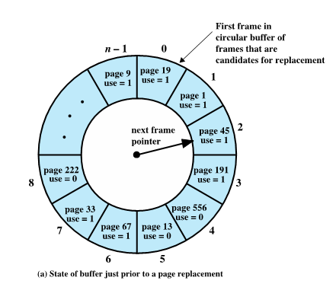

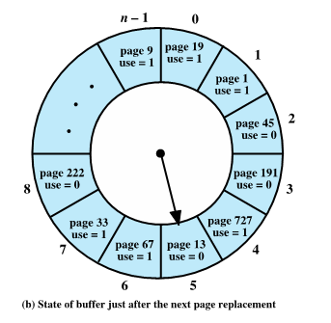
Clock Policy: An Example
Notes:
This is an example of the simple clock policy mechanism. A circular
buffer of n main memory frames is available for page replacement. Just prior
to the replacement of a page from the buffer with incoming page 727 , the next frame
pointer points at frame 2, which contains page 45 . The clock policy is now executed.
Because the use bit for page 45 in frame 2 is equal to 1, this page is not replaced.
Instead, the use bit is set to 0 and the pointer advances. Similarly, page 191 in frame
3 is not replaced; its use bit is set to 0 and the pointer advances. In the next frame,
frame 4, the use bit is set to 0. Therefore, page 556 is replaced with page 727 . The
use bit is set to 1 for this frame and the pointer advances to frame 5, completing the
page replacement procedure.

Slide 26
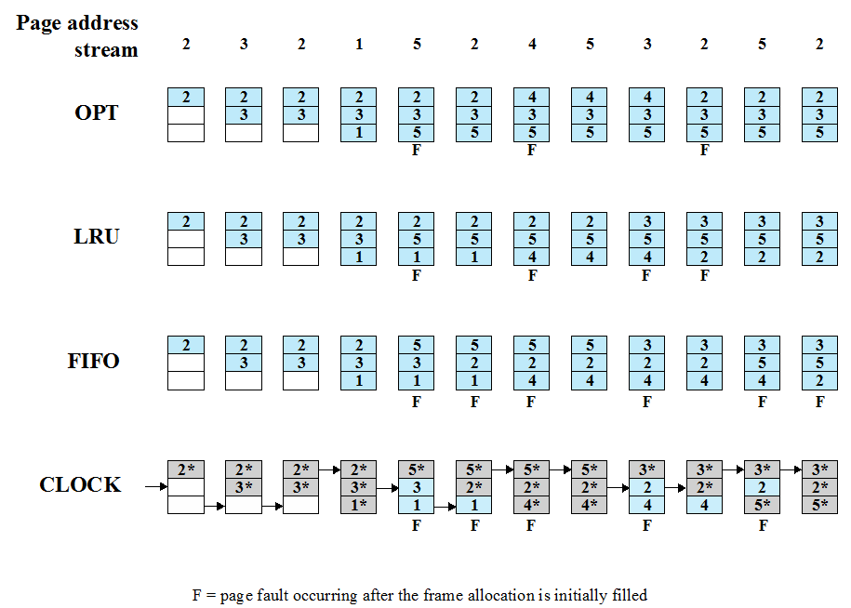
Notes:
The optimal policy selects for replacement that page for which the time to the next
reference is the longest. It can be shown that this policy results in the fewest number of
page faults [BELA66]. Clearly, this policy is impossible to implement, because it would
require the operating system to have perfect knowledge of future events. However, it
does serve as a standard against which to judge real-world algorithms.
Figure 8.14 gives an example of the optimal policy. The example assumes a
fixed frame allocation (fixed resident set size) for this process of three frames. The
execution of the process requires reference to five distinct pages. The page address
stream formed by executing the program is
2 3 2 1 5 2 4 5 3 2 5 2
which means that the first page referenced is 2, the second page referenced is 3, and
so on. The optimal policy produces three page faults after the frame allocation has
been filled.

Slide 27
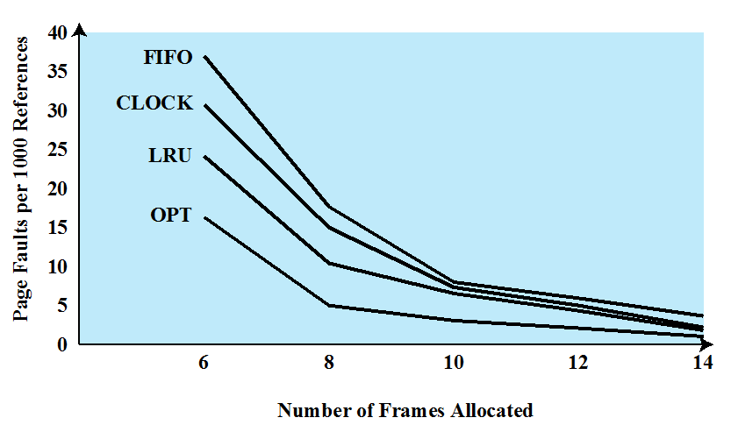
Comparisons of the Page Replacement Algorithms
Notes:
This figure shows the results of an experiment reported in [BAER80], which
compares the four algorithms that we have been discussing; it is assumed that the
number of page frames assigned to a process is fixed. The results are based on the
execution of 0.25 x 10⁶ references in a FORTRAN program, using a page size of 256
words. Baer ran the experiment with frame allocations of 6, 8, 10, 12, and 14 frames.
The differences among the four policies are most striking at small allocations, with
FIFO being over a factor of 2 worse than optimal. All four curves have the same shape
as the idealized behavior. In order to run efficiently, we would
like to be to the right of the knee of the curve (with a small page fault rate) while
keeping a small frame allocation (to the left of the knee of the curve). These two constraints
indicate that a desirable mode of operation would be at the knee of the curve.
The clock algorithm has also been compared to these other algorithms when
a variable allocation and either global or local replacement scope (see the following
discussion of replacement policy) is used [CARR81]. The clock algorithm
was found to approximate closely the performance of LRU.

Slide 28
Resident Set Management
The OS must decide how many pages to bring into main memory
the smaller the amount of memory allocated to each process, the more processes can reside in memory
small number of pages loaded increases page faults
beyond a certain size, further allocations of pages will not effect the page fault rate
Notes:
With paged virtual memory, it is not necessary and indeed
may not be possible to bring all of the pages of a process into main memory to
prepare it for execution. Thus, the operating system must decide how many pages to
bring in, that is, how much main memory to allocate to a particular process. Several
factors come into play:
• The smaller the amount of memory allocated to a process, the more processes
that can reside in main memory at any one time. This increases the probability
that the operating system will find at least one ready process at any given time
and hence reduces the time lost due to swapping.
• If a relatively small number of pages of a process are in main memory, then,
despite the principle of locality, the rate of page faults will be rather high (see
Figure 8.10b ).
• Beyond a certain size, additional allocation of main memory to a particular
process will have no noticeable effect on the page fault rate for that process
because of the principle of locality.

Slide 29
Resident Set Size
Fixed-allocation
Variable-allocation
gives a process a fixed number of frames in main memory within which to execute
when a page fault occurs, one of the pages of that process must be replaced
allows the number of page frames allocated to a process to be varied over the lifetime of the process
Notes:
With these factors in mind, two sorts of policies are to be found in contemporary
operating systems. A fixed-allocation policy gives a process a fixed number of
frames in main memory within which to execute. That number is decided at initial
load time (process creation time) and may be determined based on the type of process
(interactive, batch, type of application) or may be based on guidance from the
programmer or system manager. With a fixed-allocation policy, whenever a page
fault occurs in the execution of a process, one of the pages of that process must be
replaced by the needed page.
A variable-allocation policy allows the number of page frames allocated to a
process to be varied over the lifetime of the process. Ideally, a process that is suffering
persistently high levels of page faults, indicating that the principle of locality
only holds in a weak form for that process, will be given additional page frames
to reduce the page fault rate; whereas a process with an exceptionally low page
fault rate, indicating that the process is quite well behaved from a locality point of
view, will be given a reduced allocation, with the hope that this will not noticeably
increase the page fault rate. The use of a variable-allocation policy relates to the
concept of replacement scope, as explained in the next subsection.
The variable-allocation policy would appear to be the more powerful one.
However, the difficulty with this approach is that it requires the operating system to
assess the behavior of active processes. This inevitably requires software overhead
in the operating system and is dependent on hardware mechanisms provided by the
processor platform.

Slide 30
Summary
Hardware and control structures
Combined paging and segmentation
Protection and sharing
OS software
Fetch policy
Placement policy
Replacement policy
Resident set management

